Slide 1

Saginaw Valley State University
Accommodations for Pregnant and Nursing Students and Employees
April 18, 2025

Slide 2
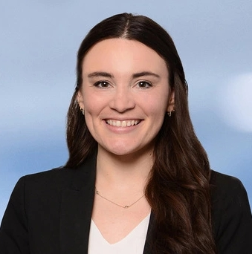
Presenter Information
Kylie E. Stryffeler
Attorney
Kstryffeler@brickergraydon.com
Bricker Graydon LLP

Slide 3

Today’s Roadmap/Objectives
Focusing on Current impacts to Higher Education
Identify current Legal Landscape generally
  Title IX
  Your Policy
  Various other laws (including employment laws)
  Takeaways from Law/Guidance
Learn from colleagues
  Recent OCR Resolution Agreements
  Litigation Update
Q&A

Slide 4
Employees ≠ Students
Employees:
FLSA/PUMP
PWFA
FMLA
PDA/TITLE VII
These laws are specific to employment and these protections do not translate over to students.

Slide 5
What applies to students?
Title IX
Section 504 of the Rehabilitation Act
ADA
Fair Housing Act
State Laws
University policies

Slide 6
Title IX (1 of 2)
20 U.S.C. §1681 et seq.
“No person in the United States shall, on the basis of sex, be excluded from participation in, be denied the benefits of, or be subjected to discrimination under any education program or activity receiving Federal financial assistance.”

Slide 7
Title IX (2 of 2)
34 C.F.R § 106.21(c)
  No discrimination on the basis of Marital or Parental Status - Admissions
34 C.F.R § 106.40
  No discrimination on the basis of Marital or Parental Status - Students
34 C.F.R § 106.57
  No discrimination on the basis of Marital or Parental Status – Employees
Non-Regulatory Guidance
  Supporting the Academic Success of
  Pregnant and Parenting Students (July 1991, reprinted June 2013)
  Discrimination Based on Pregnancy and Related Conditions (October 2022)

Slide 8
General Principles
Non-Discrimination
  Are you requiring someone to do something different because they are pregnant or because they are a parent?
  If you had a non-pregnant person or non-parent ask for the same accommodation or leave in any other circumstance, would you grant it to them?
Remember: Parents and pregnant people generally maintain autonomy to choose how to navigate their education/employment.
  Informed consent is key.

Slide 9

Title IX
Current regulations and guidance

Slide 10
Discriminatory Prohibition for Students
34 C.F.R § 106.40 (a)
A recipient shall not apply any rule concerning a student's actual or potential parental, family, or marital status which treats students differently on the basis of sex.

Slide 11
Prohibition Against Exclusion of Students
34 C.F.R § 106.40(b)(1)
A recipient shall not discriminate against any student, or exclude any student from its education program or activity, including any class or extracurricular activity, on the basis of such student's pregnancy, childbirth, false pregnancy, termination of pregnancy or recovery therefrom, unless the student requests voluntarily to participate in a separate portion of the program or activity of the recipient.
Guidance says: Make “reasonable and responsive” adjustments.

Slide 12
Students - Health Certifications?
34 C.F.R § 106.40(b)(2)
A recipient may require such a student to obtain the certification of a physician that the student is physically and emotionally able to continue participation so long as such a certification is required of all students for other physical or emotional conditions requiring the attention of a physician.

Slide 13
Students - Separate Programs?
34 C.F.R § 106.40(b)(3)
A recipient which operates a portion of its education program or activity separately for pregnant students, admittance to which is completely voluntary on the part of the student as provided in paragraph (b)(1) of this section shall ensure that the separate portion is comparable to that offered to non-pregnant students.

Slide 14
Temporary Disabilities (Title IX)
34 C.F.R § 106.40(b)(4)
A recipient shall treat pregnancy, childbirth, false pregnancy, termination of pregnancy and recovery therefrom in the same manner and under the same policies as any other temporary disability with respect to any medical or hospital benefit, service, plan or policy which such recipient administers, operates, offers, or participates in with respect to students admitted to the recipient's educational program or activity.

Slide 15
Title IX & Disabilities
Holding students to academic requirements that are essential to the instruction ≠ discrimination
Declining to provide modifications if they would fundamentally alter the nature of the public service provided ≠ discrimination
Reasonable accommodations/adjustments may be requested
  Institution must engage in an interactive process to determine what accommodations are reasonable
  Medical documentation to support accommodations may be requested

Slide 16
Leaves of Absence
34 C.F.R § 106.40(b)(5)
In the case of a recipient which does not maintain a leave policy for its students, or in the case of a student who does not otherwise qualify for leave under such a policy, a recipient shall treat pregnancy, childbirth, false pregnancy, termination of pregnancy and recovery therefrom as a justification for a leave of absence for so long a period of time as is deemed medically necessary by the student's physician, at the conclusion of which the student shall be reinstated to the status which she held when the leave began.

Slide 17
Non-Discrimination on the Basis of Sex in Admissions (1 of 2)
34 C.F.R § 106.21(c): Recipients
Shall not apply any rule concerning the actual or potential parental, family, or marital status of a student or applicant which treats persons differently on the basis of sex. . .
Shall not discriminate against or exclude any person on the basis of pregnancy, childbirth, termination of pregnancy, or recovery therefrom. . .

Slide 18
Non-Discrimination on the Basis of Sex in Admissions (2 of 2)
34 C.F.R § 106.21(c): Recipients
Shall treat disabilities related to pregnancy, childbirth, termination of pregnancy, or recovery therefrom in the same manner and under the same policies as any other temporary disability or physical condition
Shall not make pre-admission inquiry as to the marital status of an applicant for admission, including whether such applicant is “Miss or “Mrs.” (unless asked of both sexes and results are not used for a discriminatory purpose)

Slide 19
Title IX/Employees (1 of 2)
34 C.F.R § 106.57:
Don’t use potential marital, parental, or family status of an employee or applicant as a reason for employment decisions
Don’t use whether an employee is the breadwinner as a reason for employment decisions
Can’t discriminate or exclude from employment on the basis of pregnancy, childbirth, false pregnancy, termination of pregnancy, or recovery therefrom

Slide 20
Title IX/Employees (2 of 2)
34 C.F.R § 106.57:
Temporary disabilities from pregnancy, childbirth, false pregnancy, termination of pregnancy, and recovery therefrom should be treated the same as the employer treats any other temporary disability
If no leave with pay is available, these are reasons for leave without pay. The employee must be reinstated to a “comparable position, without decrease in rate of compensation or loss of promotional opportunities, or any other right or privilege of employment.”

Slide 21
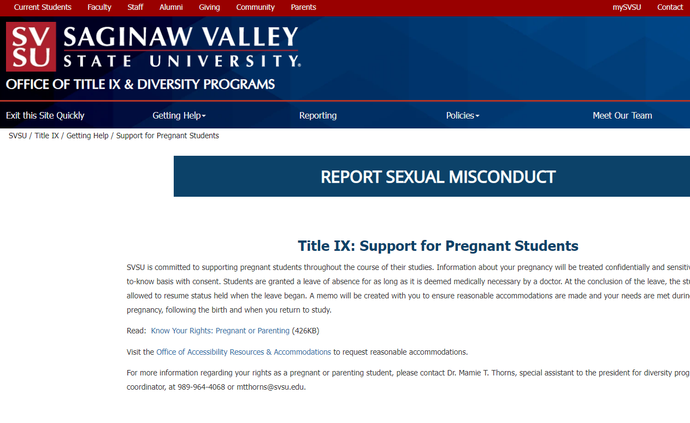
SVSU - Sexual Misconduct Policy
What does this policy cover?
“Consequently, SVSU strictly prohibits sex discrimination”
Discrimination on the basis of pregnancy is a form of sex discrimination!
This policy applies to all members of the community (staff, students, faculty, etc.)

Slide 22
Interactive Process
Report of Student in need of P&P Support
Student Meets with Title IX Coordinator and Describes Requests/Needs
Title IX Coordinator Evaluates Request (Contacts department/faculty). Assessment of fundamental alteration.
Present Students With Options
Implement Modifications

Slide 23
Absences as Modifications/Accommodations
(for students)
2013 Guidance from OCR:
Institutions are required to excuse student absences due to pregnancy or related conditions, for as long as the student’s doctor deems the absences to be medically necessary.
When the student returns to school, they must be reinstated to the same status held when the leave began, including the opportunity to make up any work missed.
As an alternative to making up missed work, the school may offer retaking a semester, taking part in an online course credit recovery program, or allowing the student additional time in a program to continue at the same pace and finish at a later date. The student should be allowed to choose how to make up the work.
Schools must ensure that the policies and practices of individual faculty members do not discriminate on the basis of pregnancy.
Fresno City College OCR case, April 2018 – Student was literally giving birth on the days the final exam was offered. Professor said she could retake the class or take an incomplete and make up the exam, but ultimately did not allow her to retake the exam. OCR noted that the College needed to provide the student the opportunity to make up the exam.

Slide 24
Accommodations for labs and other “dangerous” settings
Fact specific – no bright line test. Must work closely with stakeholders (including faculty) to assess the following issues:
  Fundamental Alteration (ADA)
  Essential to the Instruction (Section 504)
  Undue Burden (ADA)
Consider accreditation
Be flexible and INTERACTIVE
Be consistent under similar circumstances
  If the circumstances are different – and justify a different course of action – document the circumstances and course of action

Slide 25
Student Employees
Will need to accommodate both as a student and, potentially, as an employee – two analyses that may have overlapping results (e.g., may have designated lactation rooms open to students and employees with breaks during class and work)​
Some considerations:​
  Is this person here primarily as a student and who also works as an employee (e.g., as a resident assistant, cashier at the on-campus café, assistant in the library)?​
  Is this person here primarily as an employee and who also takes classes as a student (e.g., works full time in the library and takes one or two classes a semester as part of an employment benefit)?​
  What if it’s unclear (e.g., part-time student and part-time employee)?​

Slide 26
General Principles:
Treat pregnant people the same way you treat non-pregnant people who have similar needs.
Let pregnant people decide if/when they can no longer work.
When it comes to risks to pregnant people, informed consent is key. You are not their parent.

Slide 27

OCR Findings and Resolution Agreements
Learn from Colleagues

Slide 28
California Career College (February 2023)
Allegations:
  Student in nursing was told by two administrators that if she was pregnant, she would need to take a leave of absence and would not be able to complete her clinicals
  Student withdrew from the program due to pregnancy
  When Student was ready to come back, she was told she would have to complete the entire semester over again
  Resolution Agreement (no factual findings):
    College must offer the student the option to return to the Program at the same time and status in the semester as when she began her leave of absence, and will not require her to redo assignments, exams, or coursework that she had previously completed.
    If the student requires additional support to make up missed work, the College will offer the option of allowing the Student to retake the semester if she chooses.

Slide 29
Rivertown School of Beauty (September 2019)
Allegations:
  School POLICY said:
    No pregnant students in the esthetician program
    Students dismissed at seven (7) months pregnant
    Pregnancy-related appointments must be scheduled outside the school day (other appointments not restricted)
  Findings:
    The policies were in violation of Title IX and were rescinded.
    Student was provided a full refund.

Slide 30
Troy University – January 2023 (1 of 2)
OCR’s Concerns:
  Student struggled with attendance and meeting deadlines due to pregnancy-related complications, early labor, and childbirth.
  Student’s request for assistance were not promptly responded to by the Title IX Coordinator.
  Professor’s request for guidance was not responded to by the Title IX Coordinator.
  Pregnancy adjustments from professors were “ad hoc and uncoordinated and dependent on each professor’s individual interpretation” of the Title IX Coordinator’s limited guidance.
  University updated its website to include protections for pregnant students, but it was unclear whether it had provided any training for faculty and staff regarding pregnant students who request adjustments.

Slide 31
Troy University – January 2023 (2 of 2)
Resolution Agreement:
  Required training for faculty and staff who may assist pregnant students with adjustments.
  Post-training survey to determine the effectiveness of the training.
  Tracking system for pregnancy-related adjustments for students: request, responses, reasons for denial (if any)
  Removed student’s grades for the semester in question and required the University to “work to limit the negative impact on the Complainant’s future applications for financial aid that any disbursement of financial aid for the Courses may have had and reimburse the Complainant for Fall 2020 documented expenses related to any of the Courses the Complainant has since retaken.”

Slide 32
Salt Lake Community College
June 2022 (1 of 3)
  Complainant learned she was pregnant and informed her professor that she had missed or had been tardy to class as a result of morning sickness.
  Professor had an attendance policy→ three late arrivals was one absence, a student that misses 20% of the class is not eligible to pass the class.
  Student requested the ability to turn in assignments late and to excuse her absences.
  Professor agreed to allow Student to miss some (but not all) of the classes, and would apply a penalty to late assignments.

Slide 33
Salt Lake Community College
June 2022 (2 of 3)
  Student continued to struggle with morning sickness, and the Professor then advised the student to drop the class because her “health is more important than a class” and she “needed to take some responsibility for the things that were going on.”
  The Title IX Coordinator was contacted and then denied the student’s requests for academic adjustments because they would constitute “fundamental alterations” to the course. Title IX Coordinator said they corresponded with the instructor and dean but did not document those discussions.

Slide 34
Salt Lake Community College
June 2022 (3 of 3)
  OCR Found:
    The College failed to respond promptly and equitably to the Complainant’s complaint of pregnancy discrimination, in violation of Title IX.
    The College failed to engage in an interactive process with the Complainant to determine the appropriate special services and/or academic adjustments to provide in light of her pregnancy, in violation of Title IX.
    The College failed to respond promptly and equitably to the Complainant’s complaint of pregnancy discrimination, in violation of Title IX.
    The College failed to engage in an interactive process with the Complainant to determine the appropriate special services and/or academic adjustments to provide in light of her pregnancy, in violation of Title IX.

Slide 35

Litigation Updates

Slide 36
Varlesi v. Wayne State Univ. 643 Fed. Appx. 506 (6th Cir. 2016)
The Facts: Varlesi was a graduate student assigned to an internship placement. She excelled in her first year of her program, but became pregnant before her second year. She continued to excel in the classroom, but reported issues with her field placement—including that one individual there complained that Varlesi rubbed her belly, wore tight clothing, and “stimulat[ed]” men with her pregnancy. That same individual gave Varlesi a failing evaluation, despite being told two weeks before that she was “doing great.”
The Complaint: Varlesi alleged pregnancy discrimination & retaliation
The Outcome: Jury awarded the student $849,000;
The Appeal: the 6th Circuit affirmed the District Court and the Jury Award

Slide 37
Takeaways
Respond promptly
Be open minded
Document your work:
  Communication with students
  Communication with staff/faculty
  Communication with the Title IX Coordinator
Show your work→ someone unfamiliar with the matter should be able to review the files and understand why/how decisions were made.
Treat students equitably.
Keep the Title IX Coordinator Involved!

Slide 38
Final Thoughts
The law sets the floor, not the ceiling.
How your treat your students and employees figures not just into legal compliance, but also:
  Retention
  Recruiting
  Public Relations
  Donations
What is both compliant and consistent with your institution’s ethic of care?

